Slide 1
EEM 301 SIGNALS & SYSTEMS
Chapters
1 – Systems
2 – Signals
3 – Convolution
4 – Fourier Series
5 – Discrete-time Fourier Series
6 – Fourier Transform
7 – Discrete-time Fourier Transform

Slide 2
SYSTEMS
Classification of Systems
Differential Equation Models and the p-Operator
Difference Equation Models and the q-Operator
Solution of Linear Differential Equation
Solution of Linear Difference Equation
Stability

Slide 3
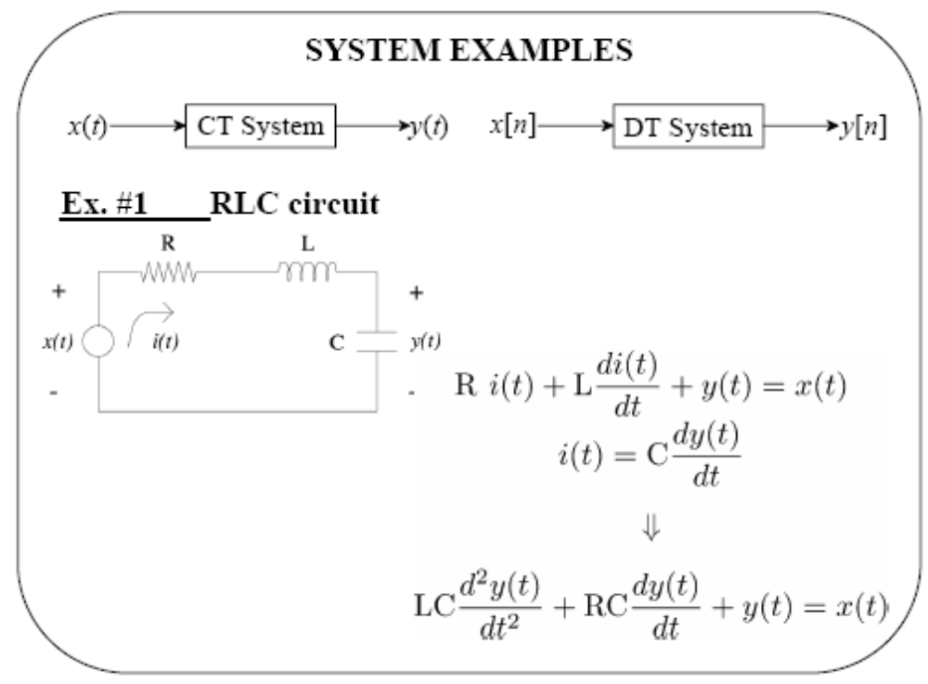

Slide 4
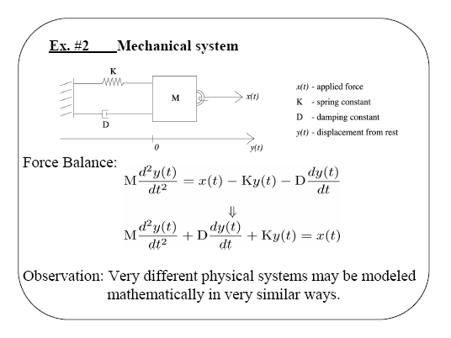

Slide 5
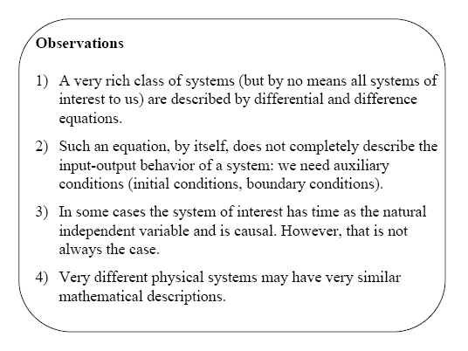

Slide 6
Classification of Systems
Static and dynamic systems: A system is said to be static if its
outputs at any instant depend only on the present value of the
inputs. A circuit that has only resistors is static system. A system
is said to be dynamic if its outputs depend on the present as well
as the past values of the inputs. Such a system may be regarded
as one with memory. A circuit that has one or more energy
storing elements such as C or L is a dynamic system.
All dynamic systems can mathematically be represented by
differential/difference equations.

Slide 7
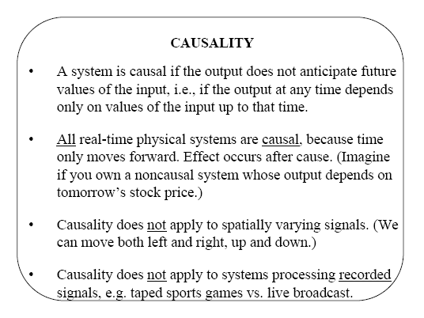
Causal (nonanticipatory) and noncausal (anticipatory) systems

Slide 8
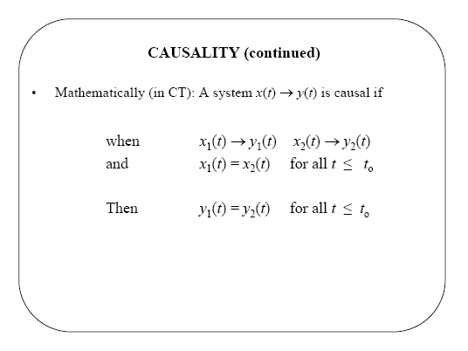

Slide 9
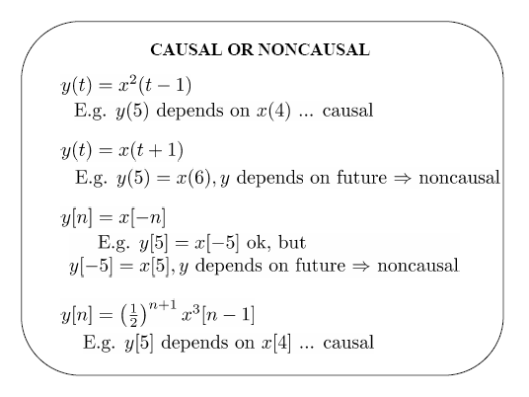

Slide 10
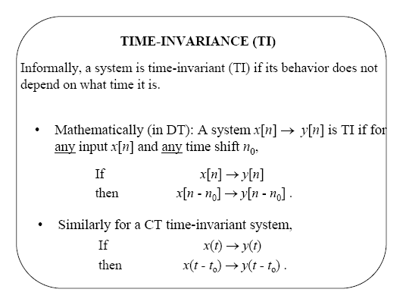
Time-invariant and time-varying systems

Slide 11
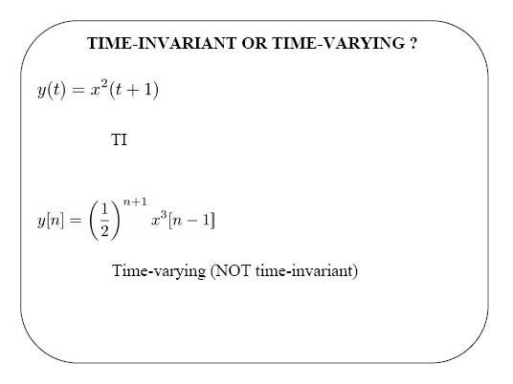
x(t-t₀) → y(t-t₀)=x²((t-t₀)+1)
x[n-n₀] → y₁[n]=(1/2)^{n+1}x³[n-n₀-1] ≠ y[n-n₀]

Slide 12
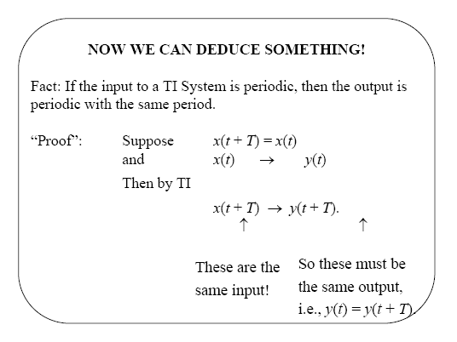

Slide 13
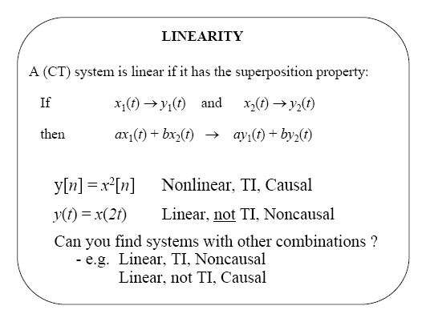
Linear and nonlinear systems

Slide 14
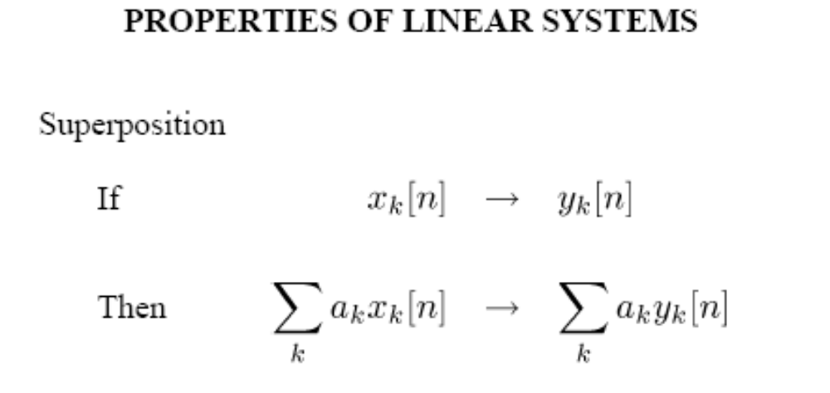

Slide 15
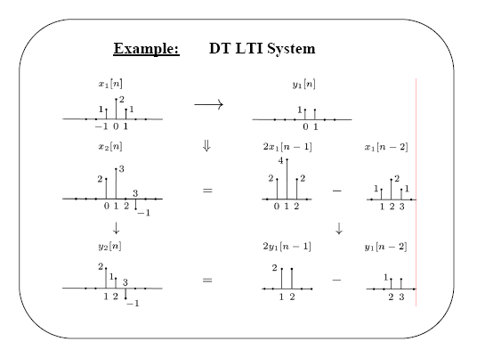

Slide 16
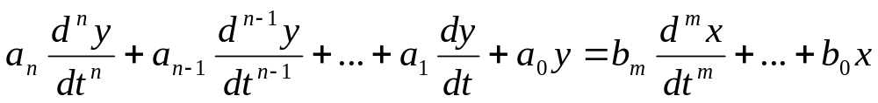
In general, a linear CT system is described by n-th order
ordinary differential equation,
where x is the input, y is the output, a_{i}, b_{j} are real constants; m, n are integers. The order “n” of the differential equation gives the order of the system and usually n≥m.
We introduce the operator “p” to replace “d / dt” in the above equation,
(a_{n} p^{n} + a_{n-1} p^{n-1} + … + a₁ p + a₀) y(t) =
(b_{m}p^{m}+b_{m-1}p^{m-1}+ … + b₁p + b₀) x(t)
or
D(p) y(t) = N(p) x(t)

Slide 17
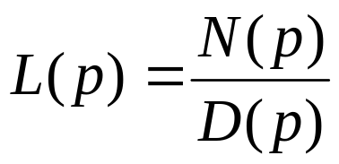
where D(p), N(p) are polynomials in p;
D(p) = a_{n} p^{n} + a_{n-1} p^{n-1} + … + a₁ p + a₀
N(p) = b_{m} p^{m} + b_{m-1} p^{m-1} + … + b₁ p + b₀
Note that py(t) is simply a short-hand notation for the first order
derivative w.r.t. (with respect to) time. However y(t)p does not
have any meaning, i.e. py(t) ≠y(t)p; it does not satisfy the
commutativity property.
=> y(t) = L(p) x(t) where
is called the system operator or the operational transfer function or the system function of the system. L(p) is a rational function and for most physical systems it is a proper rational function, i.e. n≥m.

Slide 18
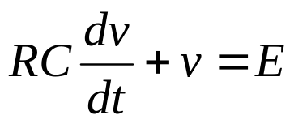
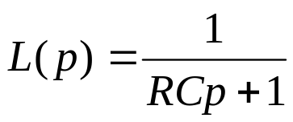
Example
Consider a series RC circuit. Kirchhoff’s voltage law yields,
Using the operator notation, we get
(RCp+1) v = E
R
i
+
+
The system operator for this circuit is
E
v
C
-
-

Slide 19
Deterministic and stochastic systems
A system is said to be deterministic if the system operator L(p),
as well as the input(s) are known exactly. For such a system the
output(s) for any given input can be determined for all future time
if all the initial conditions are known.
If the parameters of the system operator or the input are not
known precisely but can be described only in a statistical sense,
such systems are called stochastic. Most real systems are subject
to random disturbances and therefore most systems in the real
world are stochastic in nature. However, we will consider only
linear time-invariant (LTI) deterministic systems.

Slide 20
Continuous-time and discrete-time systems
If time takes any value in the continuous set of real numbers,
such system descriptions are called continuous-time (CT) systems.
For example, RLC circuits or mechanical systems involving
motions of particles fall into this category.
With the advent of digital components and devices, the essential
features of the input and output signals are of interest only at
specific instants of time, given by
t = nT
-2 -1 0 1 2 3 4 5 6
nT
where n is an integer and T is called the sampling interval. Such systems are called discrete-time (DT) systems.

Slide 21
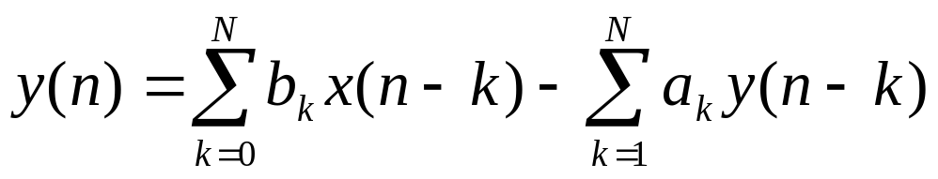
DT LTI systems are described by, not differential,
but difference equations. A general form of order n is
y(n) + a₁ y(n-1) + . . . + a_{N-1} y(n-N+1) + a_{N} y(n-N)
= b₀ x(n) + b₁ x(n-1)+ …+ b_{N} x(n-N)
or
Note that the input and output are defined only at discrete values of time, i.e. nT and x(n), n=0,1, … are the input sequences, y(n), n=0,1,.. are the output sequences.
Let “q” denote the shift operator that advances the sequence by one time interval; q x(n) = x(n+1)

Slide 22
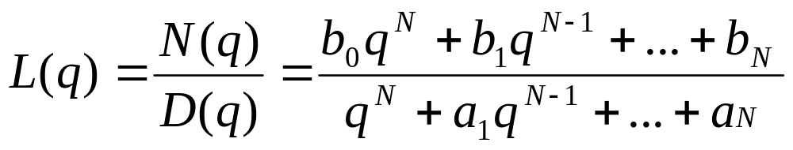
Similarly, the inverse of q is the unit delay operator, i.e.
q⁻¹ x(n) = x(n-1)
With this operator, the general difference equation becomes,
(1+a₁ q⁻¹ +…+a_{N} q^{-N}) y(n) = (b₀ + b₁ q⁻¹ +…+b_{N} q^{-N}) x(n)
Multiplying both sides by q^{N}, we get
(q^{N} +a₁q^{N-1} +…+a_{N} ) y(n) = (b₀q^{N} +b₁q^{N-1} +…b_{N}) x(n)
Hence, the linear DT system function is defined as

Slide 23
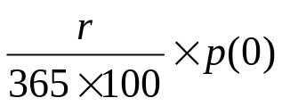
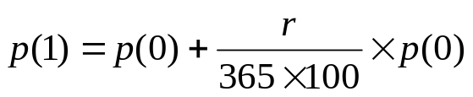
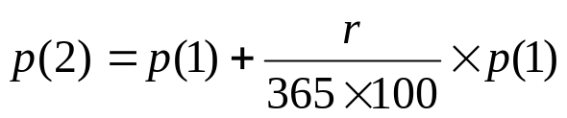
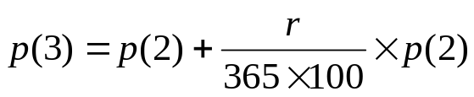
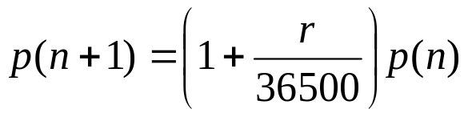
Example: We can develop a model of a savings account that pays compound
interest daily. Let the original amount be denoted by p₀ and the rate of interest
by r percent per annum. At the end if the 1st day, amount of one day interest is
where p(0)=p₀ (i.e. initial day amount). So the following days we have,
....
The last general expression gives us the 1st order linear time invariant (LTI) discrete-time (DT) model where the period T is equal to a day.

Slide 24
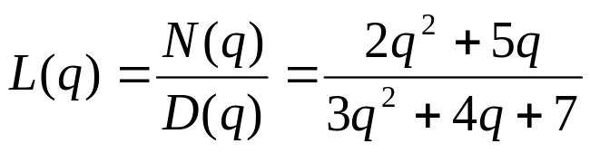
Example: Consider,
3y(n)+4y(n-1)+7y(n-2) = 2x(n)+5x(n-1)
We introduce the q-operator as
(3+4q⁻¹ +7q⁻² ) y(n) = (2+5q⁻¹ ) x(n)
Multiply both sides by q², we obtain
(3q² +4q+7) y(n) = (2q² +5q) x(n)
or
D(q) y(n) = N(q) x(n)
Hence, the system function is

Slide 25


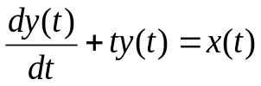
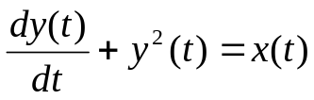
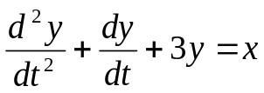
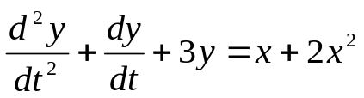
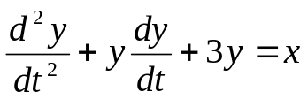


Example
System Description S/D_L/NL_TI/TV_CT/DT_Order

Slide 26
Solution of Linear Differential Equation
With operator notation,
D(p) y(t) = N(p) x(t)
where D(p) is a polynomial of degree n with coefficient of p^{n} equal to 1.
Such polynomials are called monic polynomial. For a unique solution we
need n initial conditions (ic), i.e. the values of y and its first n-1 derivatives
at t=0.
The complete solution y(t) consists of two parts; complementary function
and particular integral:
(i) Complementary function; is the solution to the homogeneous eq. (HE)
i.e. no input, x(t)=0. This solution is also known as the
natural (free) or zero-input response of the system, denoted by y_{c}(t).
(ii) Particular integral; is the component of the solution due to the forcing
function x(t) and is independent of the initial conditions. It is also called
forced or zero-state response of the system, denoted by y_{p}(t).
y(t) = y_{c}(t) + y_{p}(t)

Slide 27
Determining the complementary function
Homogeneous differential eq.: D(p) y(t) = 0
The characteristic eq (CE): D(p) = a_{n} p^{n} + a_{n-1} p^{n-1} + … + a₁ p + a₀ = 0
where the n roots r_{i} are called natural modes.
The complementary function will have the form,
y_{c}(t) = A₁ y₁(t) + A₂ y₂(t) +…+ A_{n} y_{n}(t)
where A_{i} are constants depending on the ic as well as the particular integral
and y_{i}(t) are exponential functions of the form:
For each distinct real root, r_{i}, the function y_{i}(t) is e^{rt}
For each pair of complex conjugate roots a±jb, the functions are of the
form e^{at} cosbt and e^{at} sinbt.
(iii) For each real root with multiplicity m, the functions are e^{rt}, te^{rt}, .., t^{m-1}e^{rt}.
(iv) For a±jb with multiplicity m, the functions are e^{at} cosbt, e^{at} sinbt,
te^{at} cosbt, te^{at} sinbt, …, t^{m-1}e^{at} cosbt, t^{m-1}e^{at} sinbt.

Slide 28
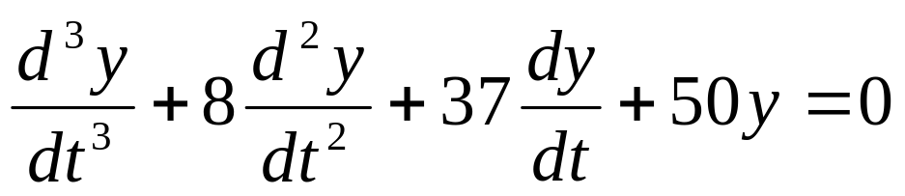
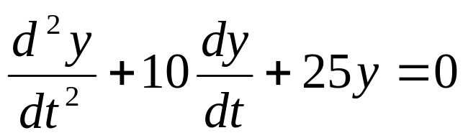
Examples
(a)
=> D(p) = p³ +8p² + 37p + 50 = 0 => roots: -2, -3±j4
y_{c}(t) = A₁ e^{-2t} +A₂ e^{-3t} cos4t + A₃ e^{-3t} sin4t
(b)
D(p) = p² +10p+25 = 0 => roots: -5, -5
y_{c}(t) = A₁ e^{-5t} + A₂ te^{-5t}

Slide 29
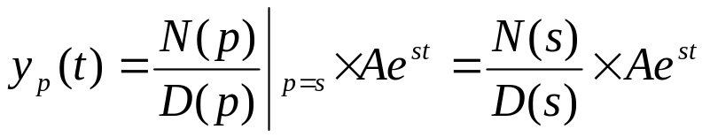
Determining the particular integral
Non-homogeneous eq. (NHE): D(p) y_{p}(t) = N(p) x(t)
where y_{p}(t) is the particular integral satisfying NHE and
often called the forced response of the system.
For the special type of input x(t) = A e^{st}, y_{p}(t) is obtained as
where s is real or complex quantity.
Note that this method does not apply to all input functions. If x(t)
is a sinusoid => x(t)=Acosωt=Re[Ae^{jωt}], x(t)=Asinωt=Im[Ae^{jωt}]
where s=jω.
The more general type of input; x(t) = A e^{at} cosbt = Re[Ae^{st}]
where s=a+jb.

Slide 30
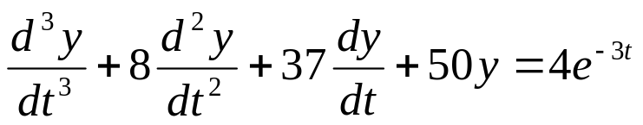
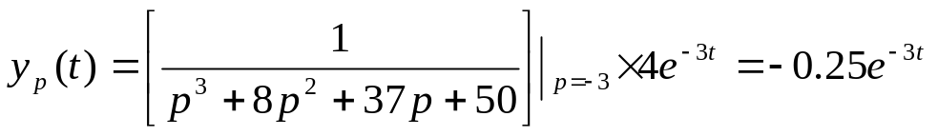
Examples
(a)
=> (p³ +8p² +37p+50) y(t) = 4e^{-3t}
The particular integral is obtained as
(b) We repeat with x(t) = 4 cos3t
=> (p³ +8p² +37p+50) y(t)=4cos3t=Re[4e^{st}], where s=j3

Slide 31

The complete solution: y(t) = y_{c}(t) + y_{p}(t)
Example
Hence, the complete solution is
y(t) = y_{c}(t)+y_{p}(t) = A₁e^{-2t} +A₂e^{-3t} cos4t+A₃e^{-3t} sin4t - 0.25 e^{-3t}
where A₁, A₂, A₃ are to be evaluated to satisfy ic.
Let y(0) = 1, y’(0) = 2, y”(0) = 1
From the complete solution we have at t=0;
y(0) = A₁ + A₂ – 0.25 = 1
y’(0) = - 2A₁ - 3A₂ + 4A₃ + 0.75 = 2
y’’(0) = - 4A₁ - 7A₂ - 24A₃ – 2.25 = 1
=> A₁ = 42/17, A₂ = - 83/68, A₃ = 43/68

Slide 32
Note that if
y(t) = Ae^{at} cosbt => y’(t) = A ae^{at} cosbt – A be^{at} sinbt
and if
y(t) = Ae^{at} sinbt => y’(t) = A ae^{at} sinbt + A be^{at} cosbt
A more direct approach for obtaining the complete solution
is provided by the Laplace transforms.

Slide 33
Solution of Linear Difference Equations
A linear difference equation of order N is
y(n) + a₁ y(n-1) + . . . + a_{n-1} y(n-N+1) + a_{N} y(n-N) = b₀ x(n) + b₁ x(n-1)+ …+ b_{N} x(n-N)
=>
where the n-th sample of the output is expressed as a linear combination
of the present and N past values of the input as well as the N past values
of the output. This approach gives a simple “brute force” solution.
A closed-form solution can be obtained using the similar steps to that of
the continuous case. The operator notation yields,
(1+a₁q⁻¹ +…+a_{N} q^{-N}) y(n) = (b₀ + b₁ q⁻¹ +…+b_{N} q^{-N}) x(n)
where q is the unit advance (shift) operator.
The complete solution is made of two parts; one is the y_{c}(n) complementary
part, the other particular solution y_{p}(n);
y(n) = y_{c}(n) + y_{p}(n)

Slide 34
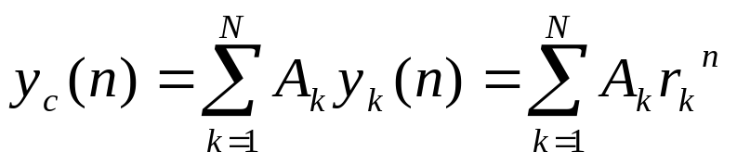
The complementary solution
Consider the HE with the characteristic polynomial as
D(q) = q^{N} + a₁ q^{N-1} + … +a_{N-1} q + a_{N} = 0
where r is any root of D(q). By direct substitution it can be
verified that the sequence
y(n) = A r^{n}
is a solution of the HE where A is a constant.
For all distinct roots, the complementary solution is of the form,

Slide 35
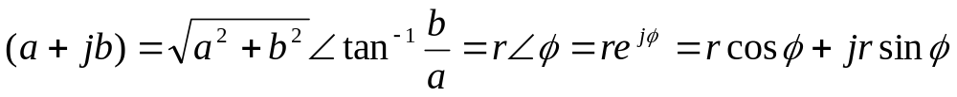
Steps
Calculate the N roots of D(q), r_{k}, k=1, 2, ..,N
For each distinct real root, the sequence y_{k}(n) is r_{k}^{n}
For each pair of complex conjugate roots, a±jb, the sequences
are of the form (a±jb)^{n} .
Note that instead of rectangular notation, one may use polar
notation as
Thus, the two sequences corresponding to the pair of complex
conjugate roots may also be written as r^{i} cosiφ and r^{i} siniφ,
obtained from
r^{n} e^{j(nφ)} = r^{n} cosnφ +j r^{n} sinnφ

Slide 36
(iv) For each multiple real root, r, of multiplicity m, the
sequences are r^{n}, n r^{n}, n² r^{n}, …, n^{(m-1)} r^{n}.
(v) For each pair of complex conjugate roots a±jb of multiplicity
m, the sequences are
(a±jb)^{n}, n (a±jb)^{n}, n² (a±jb)^{n}, …, n^{(m-1)} (a±jb)^{n}.
In the polar form, r e^{±jφ}, the sequences are
r^{n} cosnφ, r^{n} sinnφ; nr^{n} cosnφ, nr^{n} sinnφ; n² r^{n} cosnφ, n² r^{n} sinnφ; …;
n^{(m-1)} r^{n} cosnφ, n^{(m-1)} r^{n} sinnφ.

Slide 37
Examples: Consider HE,
(a) y(n) – 8 y(n-1) + 37 y(n-2) – 50 y(n-3) = 0
=> D(q) = q³ – 8 q² + 37 q – 50 = 0
=> roots: r₁ = 2, r_{2,3} = 3 ±j4 = 5 e^{±j0.93}
The complementary solution is given by the following sequences
y_{c}(n) = A₁ 2^{n} + A₂ 5^{n} cos0.93n + A₃ 5^{n} sin0.93n
(b) y(n+3) – 7 y(n+2) + 16 y(n+1) – 12 y(n) = 0
  D(q) = q³ – 7 q² + 16 q – 12 = 0
  roots: r₁ = 2, r₂ = 2, (m=2), r₃ = 3
  The complementary solution is
  y_{c}(n) = A₁ 2^{n} + A₂ n2^{n} + A₃ 3^{n}

Slide 38
The particular solution
The particular solution y_{p}(n) of the NHE (i.e. nonzero input)
depends on the forcing function and is also called the forced
response. Similar to the differential equations, the particular
solution can be determined for the special case of complex
exponential sequence.
Example
Consider NHE of Ex.(a) with the exponential sequence as,
y(n+3) – 8 y(n+2) + 37 y(n+1) – 50 y(n) = 8 (0.5)^{n}
Form D(q) y(n) = N(q) x(n)
  (q³ – 8 q² + 37 q – 50) y(n) = 8 (0.5)^{n}
Similar to the continuous case, the particular solution is
readily obtained for the given exponential sequence as

Slide 39
The complete solution
y(n) = y_{c}(n) + y_{p}(n)
The unknown constants in the complete solution are determined
in such a way that all of the boundary conditions are satisfied.
In an initial value problem, N number of initial conditions
for a N-th order difference equation must be given.

Slide 40
Example
Consider the previous example with the boundary conditions
given as y(0) = 2, y(1) = 3, y(2) = 5.
The complete solution is found as
y(n) = A₁ 2^{n} + A₂ 5^{n} cos0.93n + A₃ 5^{n} sin0.93n – (64/267) (0.5)^{n}
y(0) = A₁ + A₂ – 64/267 = 2
y(1) = 2A₁ + 5A₂ cos0.93 + 5A₃ sin0.93 – (32/267) = 3
y(2) = 4A₁ + 25A₂ cos1.85 + 25A₃ sin1.85 – (16/267) = 5
A₁ = 2.1886, A₂ = 0.05108, A₃ = - 0.35666
For the solution of difference equation, there is also a direct
approach using the z-transforms which will be presented in
the sequel.

Slide 41
Stability
Stability is directly related to the usefulness of the system
response. A system is said to be stable if the output remains
bounded for all bounded inputs.
CT: The natural response of a LTI CT system will remain
bounded ⬄ all the roots of D(p) satisfy the following;
(i) The real parts of all simple roots must be ≤ 0
(ii) The real parts of all multiple roots must be < 0
DT: The natural response of a LTI DT system will remain
bounded ⬄ all the roots of D(q) satisfy the following;
(i) The magnitude of all simple roots must be ≤ 1
(ii) The magnitude of all multiple roots must be < 1

Slide 42
For the stability of the complete response in the general
bounded-input-bounded-output (BIBO) sense;
(a) A LTI CT system is
(i) stable in the BIBO sense if all the roots of D(p) have
negative real parts,
(ii) unstable if the real part of any root ≥ 0
(b) A LTI DT system is
(i) stable in the BIBO sense if all the roots of D(q)
have magnitudes less than one,
(ii) unstable if the magnitude of any root ≥ 1
Note that we have excluded simple roots of D(p) with zero real parts in (a) and
simple roots of D(q) with magnitude equal to one in (b). The reason is that a
bounded natural response does not necessarily imply stability. e.g. simple
roots of D(p) with zero real parts will cause a bounded sinusoid in the
natural response, but the particular solution will grow out of bounds if the
input function is a sinusoid of the same frequency.

Slide 43
Example
Consider
y’’(t) + 4y(t) = x(t) => D(p) = p² + 4 = 0 => p_{1,2} = ±j2
The complementary function is
y_{c}(t) = A cos2t + B sin2t (a bounded signal)
For the input x(t)=2cos2t, the particular integral is
y_{p}(t) = 0.5 t sin2t
which will be unbounded although the input itself is bounded.

